Slide 1
Git And GitHub

Slide 2
Git is a version control system.
Git is a tool that helps us save our code, track changes, and go back to old versions if something goes wrong.
Why Git is used:
To keep a history of code changes
To work safely without losing code
To allow many people to work on the same project
To undo mistakes easily

Slide 3
GitHub is an online platform (website) that stores Git projects.
GitHub is like Google Drive for code, where we upload our Git projects and share them with others.
Why GitHub is used:
To store code online
To share code with team members
To work together on the same project
To keep a backup of code

Slide 4
Command To Upload 1st Time Project In Git Repository
To upload Project or code in Git First create folder with any name you can use Then rightclick and click on open git bash here
================================
To Initialize Use Command
Git init
============================
To create File Use Command
touch filename
eg- touch demo.txt
==============================
To insert data and save data Use Command
vi demo.txt
Then click I button and insert messang
Then click on ESC :wq button to save data

Slide 5
To Check data Use Command
cat demo.txt
=======================
to Set Configuration
git config --global user.name "Rajni0501"
=================================
To set Configuration
git config --global user.email "rajnipethe@gmail.com"
==============================
To Add project of file in git hub Use Command
git add .
===========================
To commit File
git commit -m "my first commit“
==========================================
To Check Status Use Command
git status

Slide 6
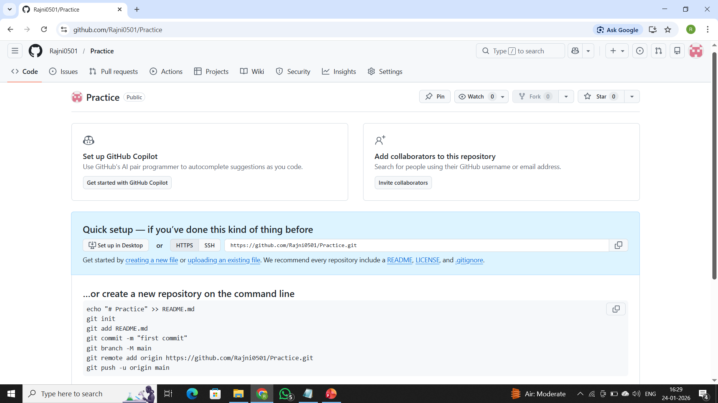
Then copy 3 last command from Github Repositoty Page for reference check below Image
Then Refresh Your Git Hub Page and You will see your project Or File is Uploaded in Repository

Slide 7
Command To Upload Project or Code 2nd Time
Open Your Project Folder from Your Sysytem then RightClick and click on Open Git bash here Option
Then Use Command git Init
Use Comman Git add .
Use Command Git commit –m “Any Message”
Use Command Git status To check file status
Then copy command from repositor as shown in previous slide and your project will get push in repository

Slide 8
THE END
THANK YOU

